Slide 1



NAME-SHUBHANWITA DAS
NISHA BOSE
YEAR- 3RD STREAM-ELECTRONICS AND COMMUNICTION ENGINNERING
SUBJECT CODE-EC 681
SUBJECT NAME-MINI PROJECT

Slide 2

SMART HOME AUTOMATION USING SOLAR PANEL

Slide 3
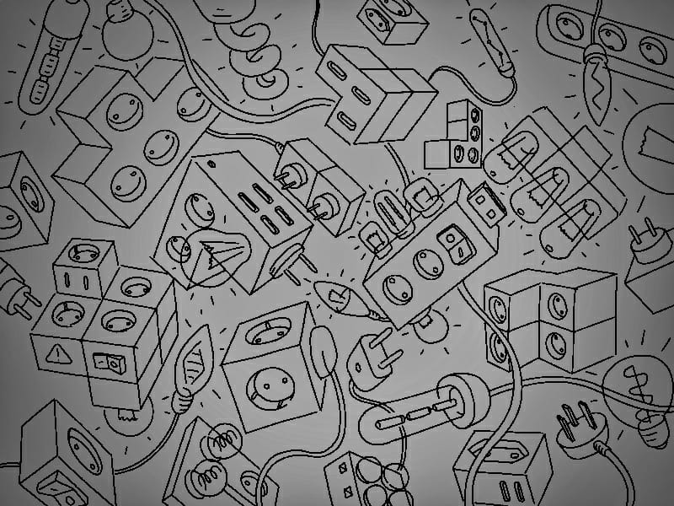
INTRODUCTION
Home automation or demotics’ is building automation for a home, called a smart home or smart house. A home automation system will control lighting, climate, entertainment systems, and appliances. It may also include home security such as access control and alarm systems. When connected with the Internet, home devices are an important constituent of the Internet of Things.
A home automation system typically connects controlled devices to a central hub or "gateway". The user interface for control of the system uses either wall-mounted terminals, tablet or desktop computers, a mobile phone application, or a Web interface, that may also be accessible off-site through the Internet.

Slide 4
IOT BASED CONTROLS
Home automation has three major parts:
Hardware
Software/Apps
Communication protocols
Some of the areas where consumers can expect to see home automation led IoT-enabled connectivity are:
Lighting control
Smart Home Appliances
Improved Home safety and security

Slide 5
SELECTION OF THE PROTOCOL
The protocol selection can now be narrowed down by the following factors:
Ability to perform identity verification
Quality of sensor networks
Data transfer rate
Security level
Network topology required

Slide 6
ARDUINO UNO BOARD
Arduino Board, The Arduino is a family of microcontroller boards to simplify electronic design, prototyping and experimenting for professionals. People use it as brains for their robots.
Arduinos (we use the standard Arduino Uno) are built around an ATmega microcontroller. The Arduino connects to your computer via USB, where you program it in a simple language (C/C++, similar to Java) from inside the free Arduino IDE by uploading your compiled code to the board.
Arduino is an opensource electronics prototyping platform based on flexible, easy-to-use hardware and software.

Slide 7
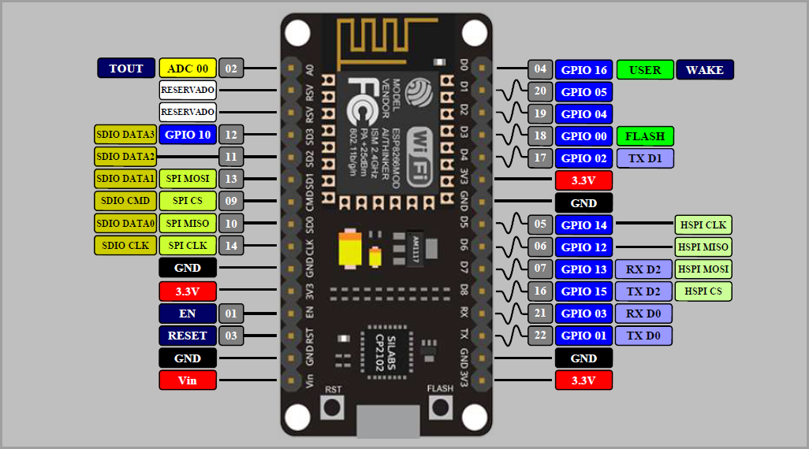
WIFI MODULE

Slide 8
ESP NODEMCU 8266
Brief About NodeMCU ESP8266
The NodeMCU ESP8266 development board comes with the ESP-12E module containing ESP8266 chip having Tensilica Xtensa 32-bit LX106 RISC microprocessor. This microprocessor supports RTOS and operates at 80MHz to 160 MHz adjustable clock frequency. NodeMCU has 128 KB RAM and 4MB of Flash memory to store data and programs. Its high processing power with in-built Wi-Fi / Bluetooth and Deep Sleep Operating features make it ideal for IoT projects.
NodeMCU can be powered using Micro USB jack and VIN pin (External Supply Pin). It supports UART, SPI, and I2C interface.

Slide 9
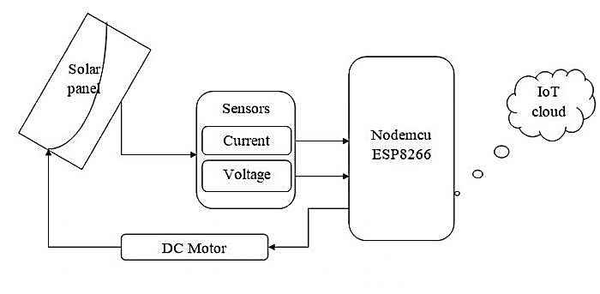
BLOCK DIAGRAM OF OVERALL PROJECT

Slide 10
COMPONENTS OF NETWORK MODLULE
Server
WIFI module - Nodemcu 8266
Switch
Smartphone
Air conditioner
Webcams
Fans
Lights
Doors
Smoke detectors
Solar panel
Battery
Temperature monitor
Windows
Garage door

Slide 11
SERVER CUSTOMIZATION
Gateway – static (IPv4)
Default gateway- 10.10.10.1
Dns server- 255.0.0
Mac address-00D0.979D.3C7A
Subnet mask- 255.0.0.0
Link local address-FE80::2D0:BCFF:FEB2:32A3
IOT registration server-ON

Slide 12
WIFI MODULE CUSTOMIZATION
Ip configuration
Default gateway- 10.10.10.2
Dns server- 255.0.0
LAN Settings
IPv4 address-192.168.25.1
subnet mask-255.255.255.0
SSID-HomeGateway
Coverage range-250.00mt

Slide 13
Smartphone Customization
Mac address-0001.430D.6571
SSID-HomeGateway
IP configuration- DHCP(IPv4)
IPv6- FE80::20A:41FF:FE19:C15C
Link Local Address-FE80::260:70FF:FE62:D767

Slide 14
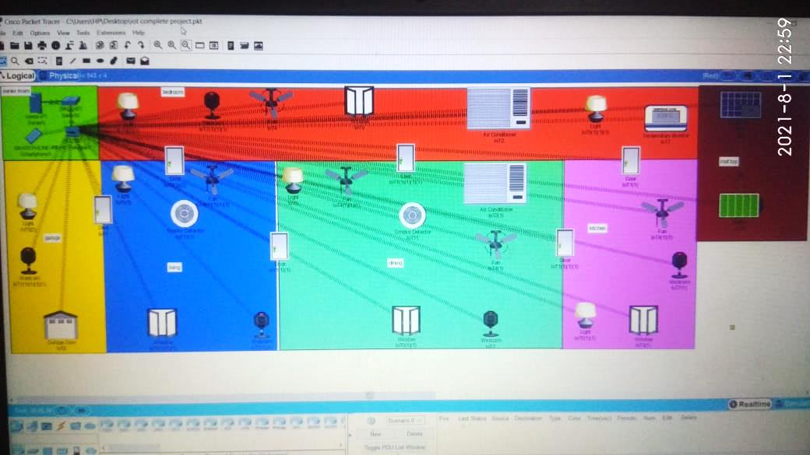
OVERALL VEIW

Slide 15
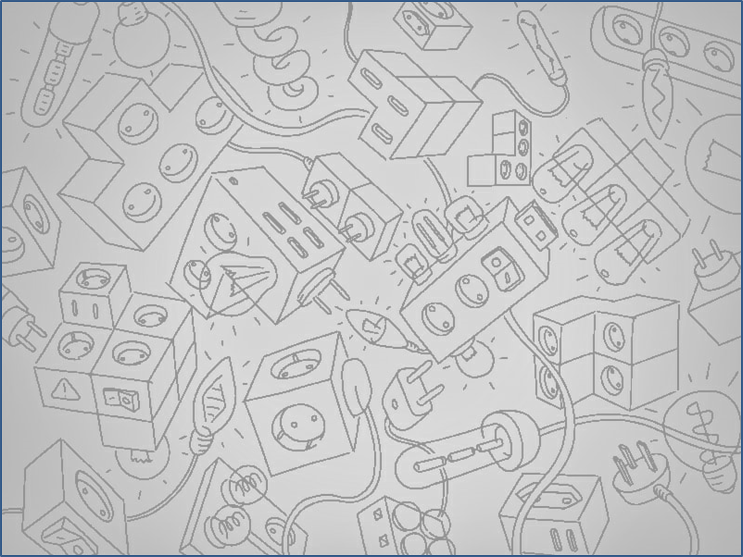
COMPONENTS OF CIRCUIT IN CONTROL ROOM
ARDUINO UNO
ACS71CTR-20A-T(12V)
MOTOR(12V)
LM016L
POT(10 ohm)
SOLAR PANEL(12V)
5 v additional dc supply

Slide 16
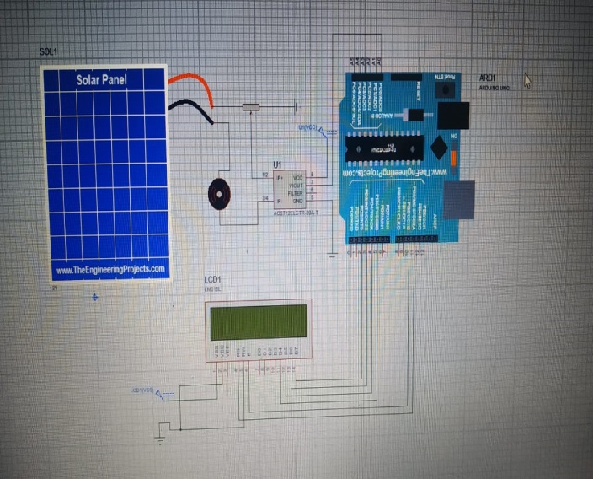
CONTROL ROOM CONNECTION
At first sunlight hits the solar panel and generate electric field and electricity flows.
Then, through potentiometer the current flows to the appliances .
In the mean time the current sensor measures the current.
Then arduino uno is connected with current sensor.
And current sensor produces the output in a analog way.
Then a LCD is connected with arduino uno.
And this LCD shows the power and current.

Slide 17
BLOCK DIAGRAM
Solar panel
Potentiometer
External 5 volt power supply
Dc motor
Current sensor
Arduino Uno
GND
GND
lcd
External 5 volt supply voltage

Slide 18
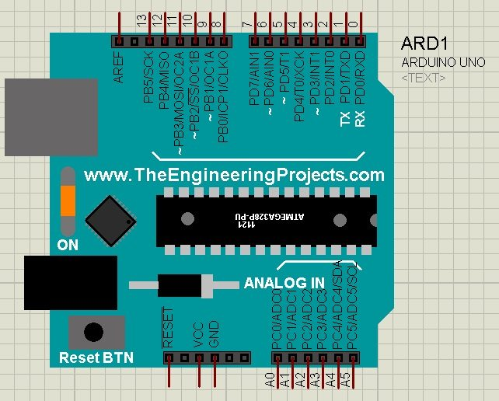
ARDUINO UNO
Arduino Uno is an open source microcontroller board.
In this circuit vout of current sensor is connected with PIN A0 of arduino.
PIN RS,E,D4,D5,D6,D7 of LCD’S is respectively connect to PIN 11,10,5,4,3,2 of Arduino uno.
And also we have to upload our code in Arduino Uno that it works properly.

Slide 19
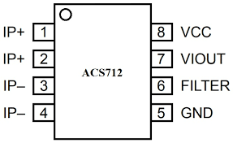
ACS71CTR-20A-T
ACS71CTR-20A-T is a current sensor. etc.

Slide 20
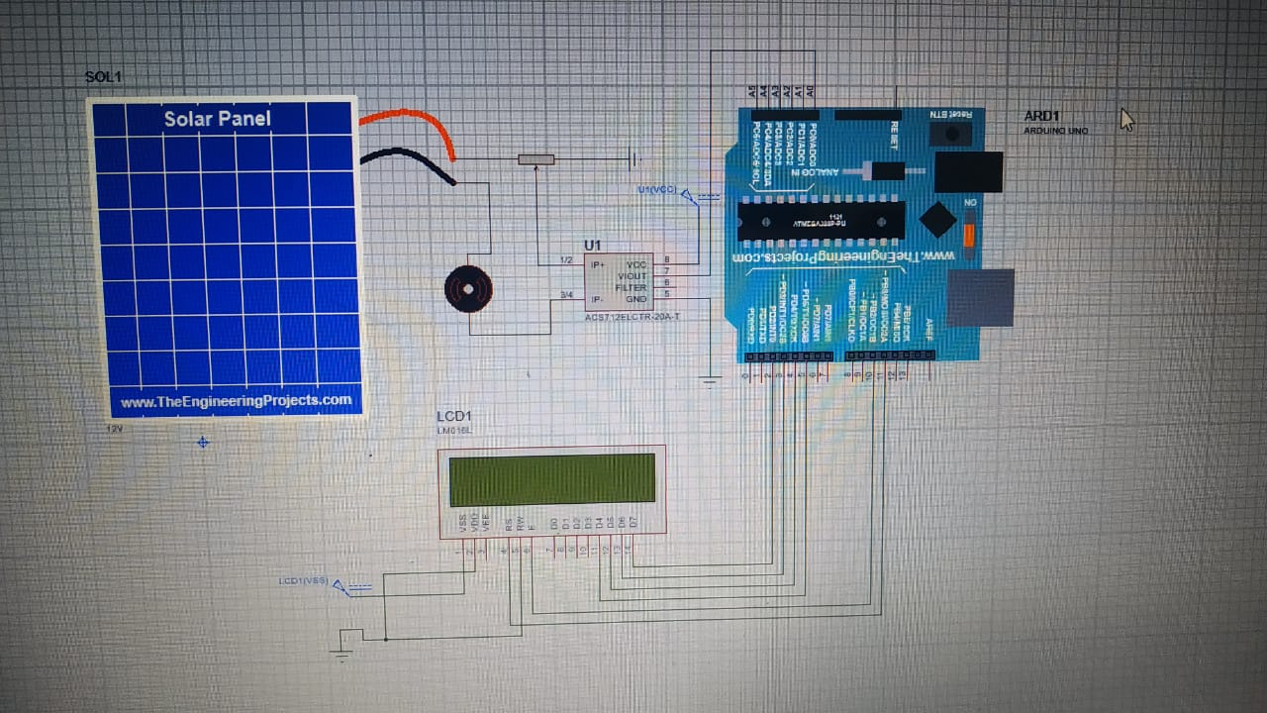
MOTOR
We use this motor as fan.
It is 12 volt dc motor.
Current flows from solar panel to motor and it connected to current sensor.
We use motor as smart home appliances.

Slide 21
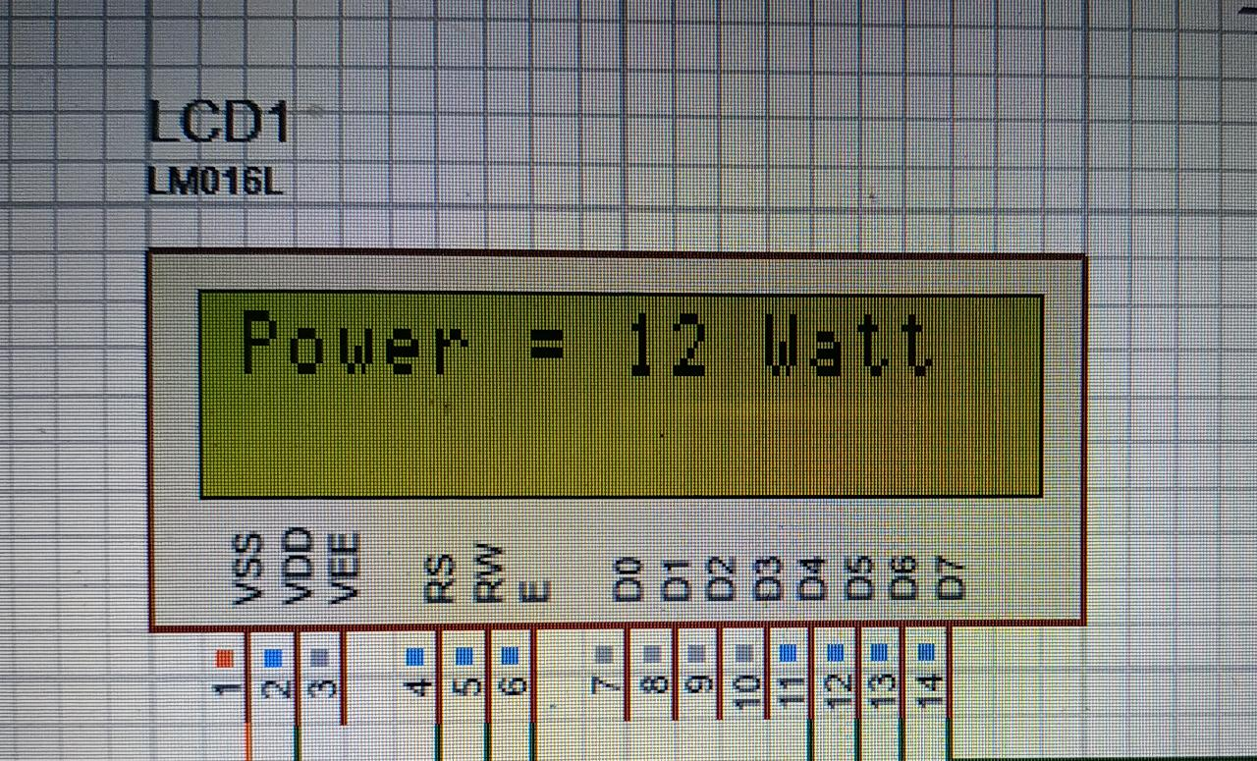
LM016L
This is 16*2 pin LCD .
It stands for liquid crystal display.
It’s VSS is connected to 5 volt dc generator.
And VDD and RW both are connected to GND.
RS,E,D4,D5,D6,D7 is respectively connected to 11,10,5,4,3,2 pins of arduino uno.
Through the circuit LCD shows the power and current.
It used for showing the result of any circuit.

Slide 22
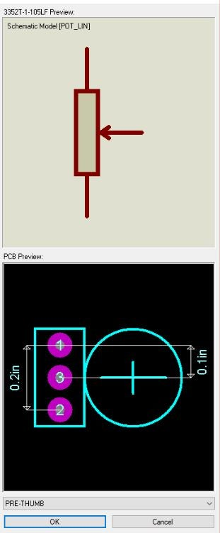
POT
It is a voltage divider used for measuring electric potential.
Potentiometer has three terminal. Here one terminal is for varying and other terminal are fixed.
In our circuit current flows from solar panel
and through potentiometer the current sensor sensing the current.
Here we use 10 ohm potentiometer.
The potentiometer is connected with ground.

Slide 23
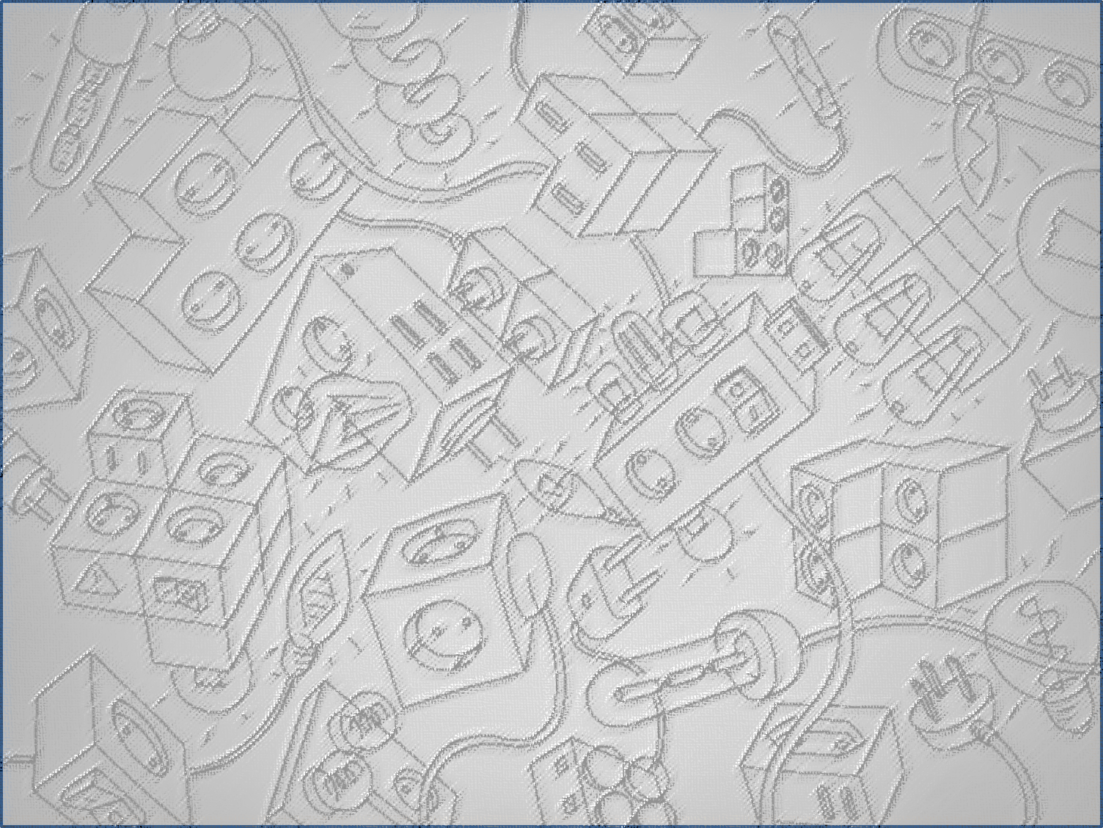
THANK YOU
CREATED BY
SHUBHANWITA DAS
NISHA BOSE

